Slide 1
UWE Bristol
Researcher Skills Development
An overview of support
Dr Paul Spencer
Researcher Skills Development Officer
UWE Graduate School
Paul.spencer@uwe.ac.uk
0117 32 83974

Slide 2


The Products of a Research Degree
Written outputs
Thesis, papers, books?
A researcher with a
set of skills
Notes:
Left hand side – this is how it used to be, you came to the Uni, signed up to do a PhD and spent 3 years writing – end product = thesis
Things have progressed/moved on – by the time you have completed your thesis there is an expectation that you will have become a skilled researcher, focus is now on the individual

Slide 3
Why the emphasis on skills?
“There should be additional training for PhD students and postdoctoral researchers, mainly in transferable skills, equivalent of two weeks per year”
– Sir Gareth Roberts (b. 1940; d. 2007 )
“SET for Success” (2002)- A report to Gov’t on the supply of educated talent to the UK economy
Notes:
The Government commissioned a report by Sir Gareth Roberts nearly 10 years ago. Innovation was deemed to be key to the future of the UK economy – emphasis on how we are preparing people for the future. A key recommendation was this (see slide). This had previously been something that was largely ad-hoc with little emphasis on generic skills. Now, this report brought with it a resource (known as Roberts funding), distributed through research councils, to provide for generic skills training for research students

Slide 4







What are these skills?
UK Research Councils produced a
“Joint Statement on Skills” (2001) which described a range of competences that should be developed by the end of a research degree
Notes:
Who’s heard of the research councils? (7 – mostly based in Swindon) They are very influential on policy and procedures for research, they distribute UK government funding for research (currently £3.7 bn) but don’t fund all research. The research councils got together to produce a ‘joint skills statement’ which shows what skills a researcher should have by the END of their research degree. It provided universities with a simple framework around which to design development programmes for doctoral students.
However, some said that as a framework it didn’t go far enough to highlight the skills beyond the research degree so the Research Councils and Vitae set about designing a new and improved framework… see next slide.

Slide 5
Researcher Development Framework
Launched in 2010
Development by Vitae in collaboration with Research Councils
Knowledge, behaviours & attitudes of researchers across a range of experience
Supersedes the JSS
http://www.vitae.ac.uk/rdf
Notes:
The Researcher Development Framework (RDF) is a new resource for 2010. It describes the knowledge, behaviours and attitudes of researchers and encorages aspiration to reach higher levels of competency.
It is designed to be an extensive checklist or audit for individuals to use and a handout explaining the RDF in detail is available.

Slide 6
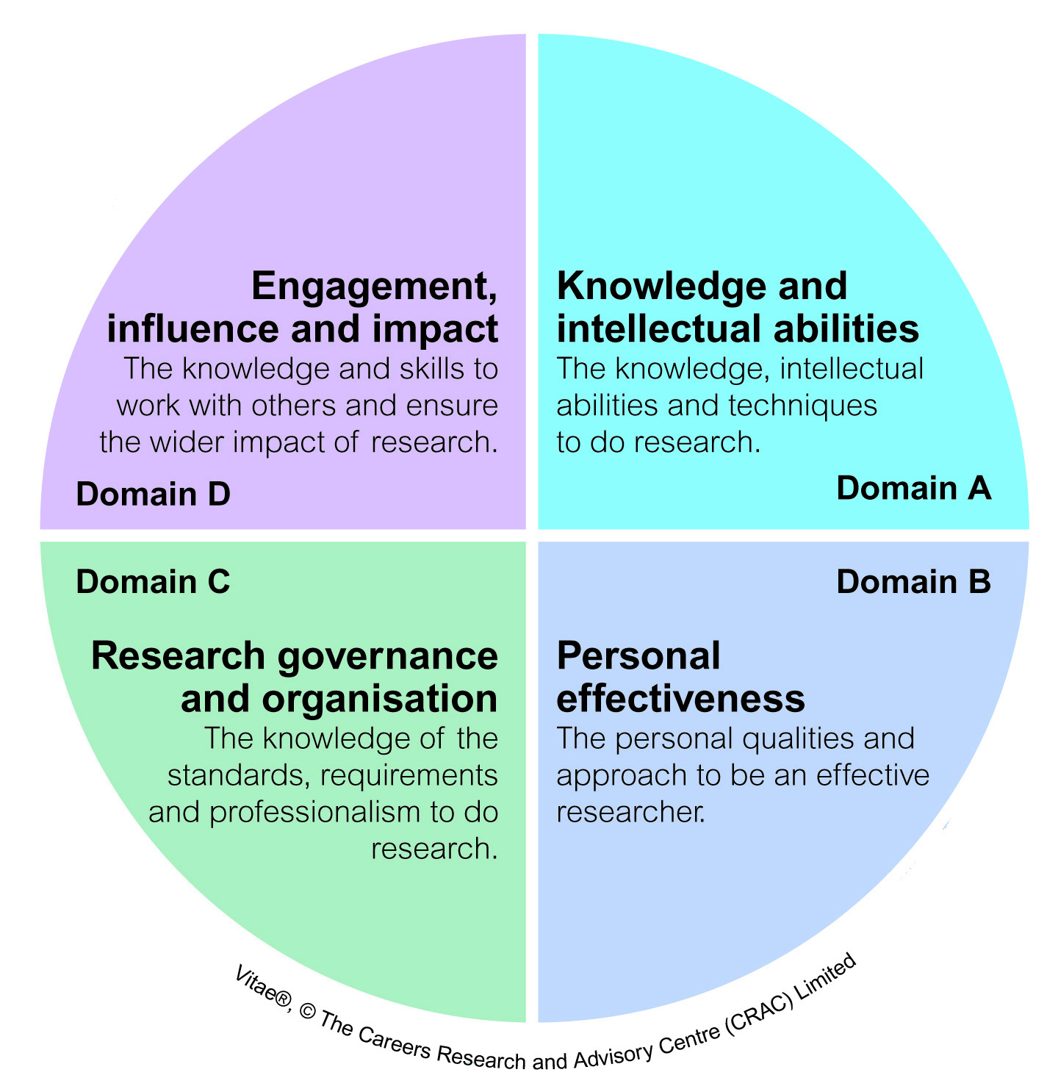

Slide 7
Where do the Graduate School fit in?
Overarching admin support for PGR
Provides an institutional focus for PGR
Broad skills development programme
Emphasis on generic/transferable skills
Complement faculty student support
Notes:
So you may wonder where RBI (Research Business and Innovation) comes into the picture. RBI is a central service in the University that supports research, eg help academics to bid for external funding from research councils, EU, etc, and also support lots of other activity around enterprise and innovation, and working with the community – visit our webpages to have a look! In RBI we hold the University’s budget for Roberts funding, and we run a programme of research development workshops to help you through your research degree, focussing on generic skills training – Paul Spencer runs this programme. This is all intended to complement the training going on in your own faculty – David Pontin will already have told/tell you about this.

Slide 8
Skills Development Programme
Practical/knowledge workshops for research degrees
The Beginners Guide to a Research Degree
The IT workshops (Microsoft Office)
The Progression Examination
Writing Up
Preparing for the Final Viva
Notes:
Refer to the Skills Development brochure
The workshops in the programme fall into 3 main categories – first one = practical/knowledge workshops. These will help you to navigate your way through the ‘process’ of a research degree.
We put on these types of workshops for two reasons; firstly we believe that it is in the best interests of research students to know about the regulations and processes that govern the research degree at UWE. Sometimes, supervisors may not have had the time to keep up with the amendments in these regulations.
Secondly, there is often anxiety around parts of the process, particularly the formal milestones (e.g. progression exam, final viva and writing up). We seek to reduce the feelings of stress but sharing best practice and offering many hints and tips.

Slide 9
RBI Skills Development Programme
Research skills (generic)
Getting Published
Research Conference Survival Guide
1st Steps to Small Group Teaching
How to win funds & influence people
Research ethics
Notes:
The second category is generic research skills. These cover such areas as: getting your research published, how intellectual property affects your work, the need for getting ethics approval to undertake your research if you involve human participants. The workshops are delivered by a variety of presenters: some external consultants, some internal members of staff with appropriate expertise.
It is worth running these as broad sessions as the principles involved are usually universal and there is a real benefit in being able to hear from and discuss these things with research students from other faculties/departments.

Slide 10
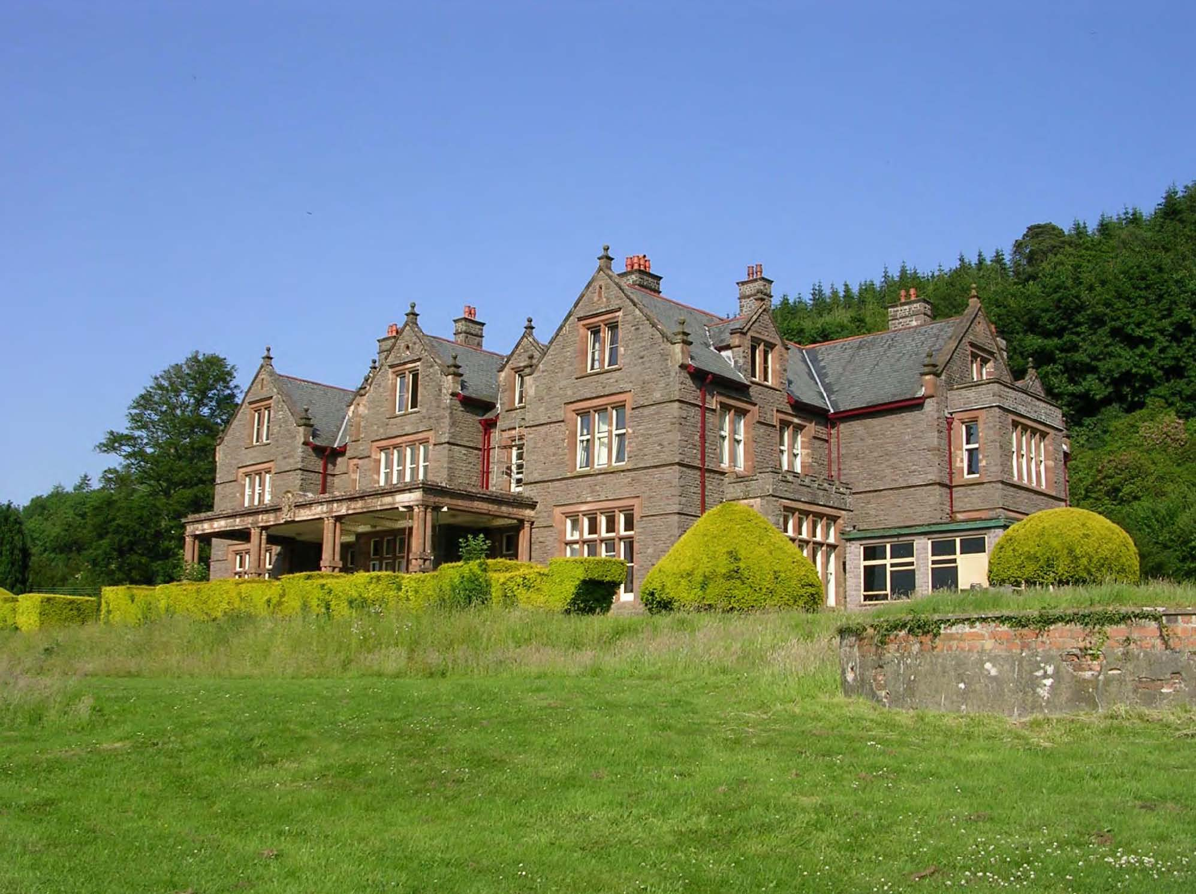
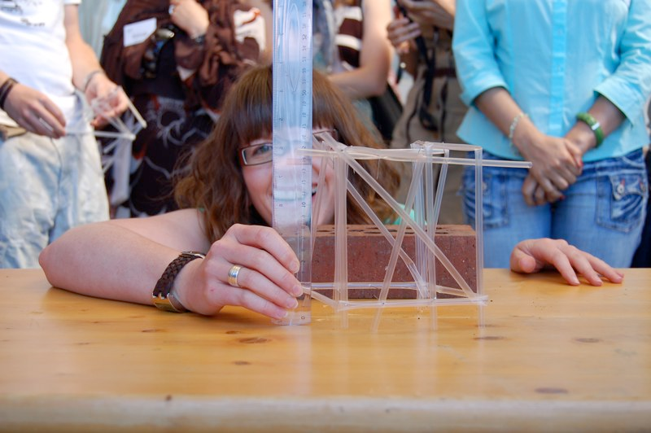
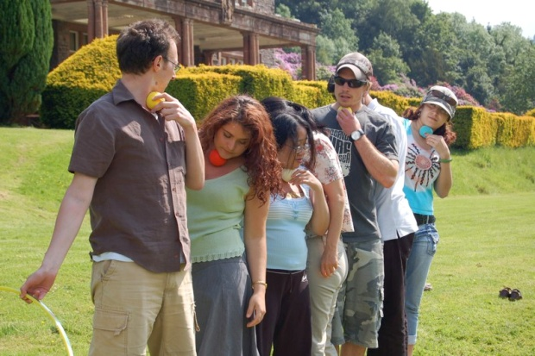
RBI Skills Development Programme
Transferable skills (the fun stuff?)
The Effective Researcher
The Effective Part Time Researcher
Art & Science of Communication
Personal Skills Development Residential
Notes:
The third category – Paul describes this as ‘the fun stuff’. My experience is largely with the residential course, which is run in May/June time, lasts for 4 days and is an opportunity to get away from the lab or library – join a group of fellow research students away from it all (in the beautiful Brecon Beacons for the past 5 years) and focus on yourself. You’ll need to have gone through your progression exam before you sign up for this one, but past attendees have found it a really valuable experience.
There are shorter, campus based courses that run in a similar style (i.e. hands on learning by doing activities!) for example the effective researcher (and part-time version recognising different challenges).
DRAW ATTENTION TO FAQs IN BROCHURE

Slide 11

Hints & tips for research students

Slide 12
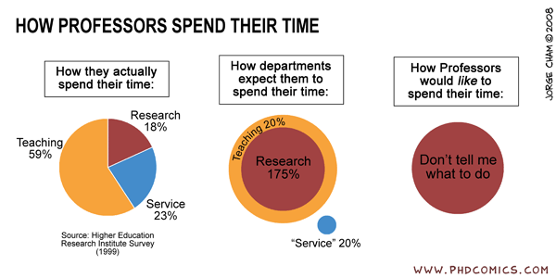
1. Supervisors are busy people
Notes:
1 – Your Director of Studies (DoS) and other supervisors in the team are very busy people. The role of an Academic these days is far from the idyllic image of wood panelled offices and plenty of spare time. Demands on time are huge with 101 competing priorities to be juggled.
Accept that your Research Degree is not top of their priority list. Also accept that it is your project therefore you must get into the habit of managing your supervisor! Be proactive and establish an effective professional working relationship with your supervisory team. Make sure regular meetings are scheduled, that you record discussions & action points agreed at meetings, that you have clear plans.

Slide 13
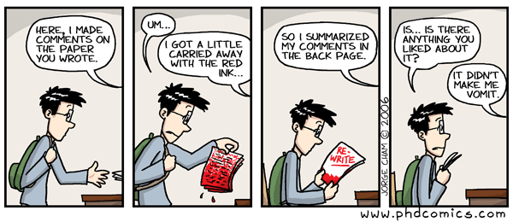
2. Write & get feedback on your work as you go along
Notes:
2 - Get feedback on your work –
Most of us do not like to receive criticism of our work even when it is delivered in the nicest possible way! In the academic environment it is more likely that your ideas will receive some tough but constructive feedback.
Remember that the feedback is NOT about you as a person but it IS about the words on a page with the express aim of knocking the work into shape so that it may ultimately be robustly defended by you when judged by experts in the field.

Slide 14
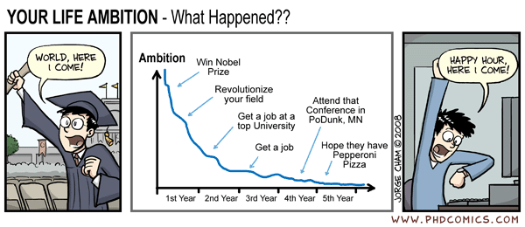
3. Be realistic – it’s not a Nobel Prize
Notes:
3 – It isn’t a Nobel Prize you are working toward, it’s a research degree with defined criteria for judging the work against.
There are no extra prizes for a perfect piece of work (in reality there is no such thing) so you will need to reach a point in your research degree journey where you accept that the work produced is of a high enough quality to be submitted and no more. A sense of “that will do”.
Remember the Law of Diminishing Return – No amount of extra effort will affect the outcome of the award.

Slide 15
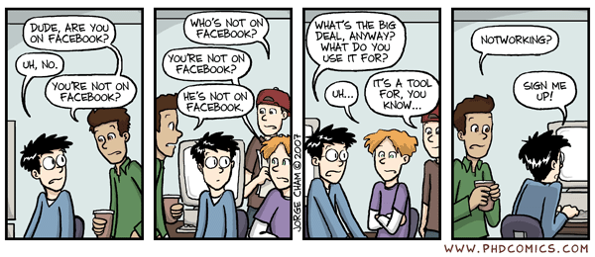
4. Beware the distractions
Notes:
4 – Strike a balance. There are a myriad of books, guides, tools, websites, gadgets etc that might help you in your research degree but ultimately none of them will write it for you.
A research degree programme will afford you a lot of freedom, academically and socially speaking, the opportunity to engage in many activities will be presented. Decide which ones ‘add’ value and which ones don’t.

Slide 16
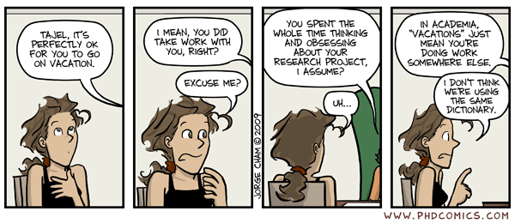
5. Take a break once in a while
Notes:
5 – Take a holiday once in a while. Really.
It does you no favours to burn yourself out by overworking, you need time to take a different perspective and to recharge. However, there is a balance to be struck!

Slide 17
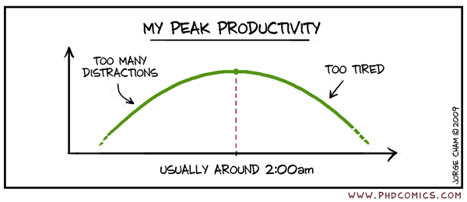
6. It’s all about work-life balance
Notes:
6. This sums up what many research students try to do, good planning can help to keep you on track.

Slide 18
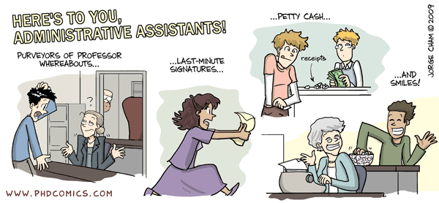
7. Get help where you can
Notes:
7 – You are not on your own, you don’t have to struggle when you encounter difficulties – ask for help, it is out there. The research student administrators have come across pretty much every eventuality/problem/regulation there is so ask. Your supervisors can offer the right help that is right for you when you ask. Other research students have the experience and shared knowledge to offer help.
If you don’t ask you might not get…..

Slide 19
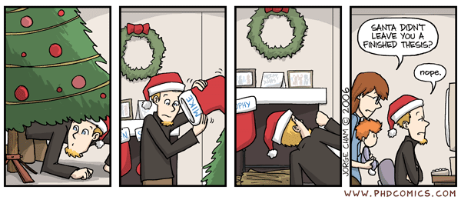
8. It’s really about persistence
Notes:
8. Accept that you are intelligent enough to do a higher degree, you wouldn’t be here if you weren’t. However, when elements of self doubt visit you and try to convince you that you are not clever enough to do a research degree, ignore it. It’s all about overcoming obstacles, being resilient to set backs and persisting until you reach your goal. That’s what it takes to complete a research degree!

Slide 20
Where do I find out more?
PGR skills development –Postgraduate Research Study Support
UWE Skills Development blog-
http://ps-spencer.posterous.com/
Vitae researcher development –http://www.vitae.ac.uk
PhD comics – http://www.phdcomics.com/

